Slide 1
Design and Analysis of Algorithms
Bellman-Ford algorithm Single-source shortest paths, all-pairs shortest paths

Slide 2
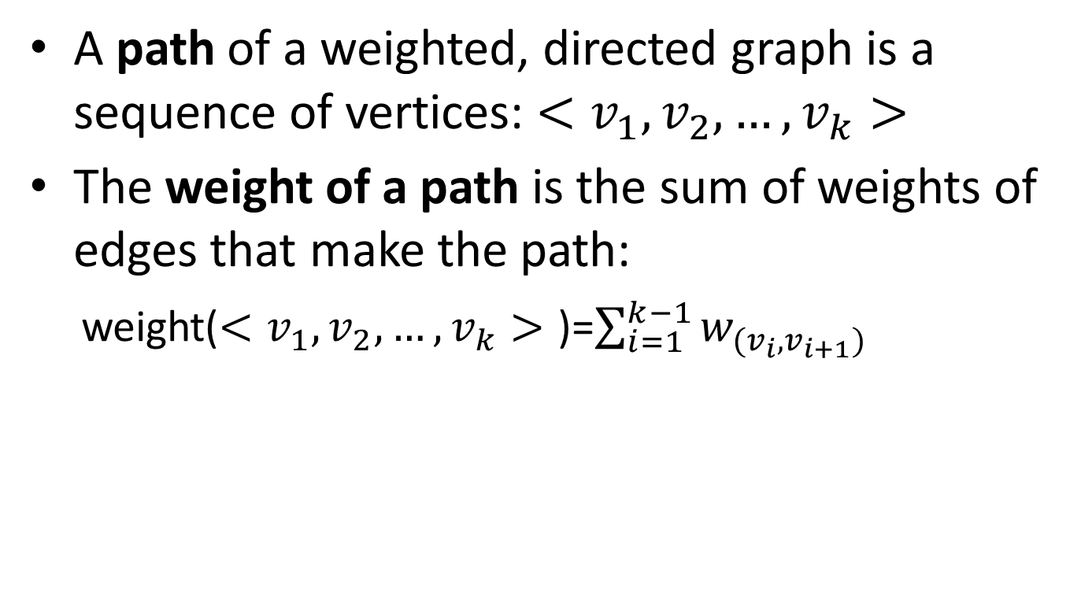
Single-source shortest paths
A path of a weighted, directed graph is a sequence of vertices: $<v_{1},v_{2}, …,v_{k}>$
The weight of a path is the sum of weights of edges that make the path:
weight($<v_{1},v_{2}, …,v_{k}>$ )=$\sum_{i=1}^{k−1}{w_{(v_{i},v_{i+1})}}$

Slide 3
Single-source shortest paths
1
2
3
10
3
2
9
1
6
4
5
7
4
5
2
Given this weighted, directed graph, what is the weight of path: <1, 2, 4>?
10+2=12

Slide 4
Single-source shortest paths
1
2
3
10
3
2
9
1
6
4
5
7
4
5
2
Given this weighted, directed graph, what is the weight of path: <1, 2, 4, 2, 4>?
10+2 + 3 + 2 = 17

Slide 5
Single-source shortest paths
1
2
3
10
3
2
9
1
6
4
5
7
4
5
2
Given this weighted, directed graph, what is the weight of path: <1, 2, 4, 1>?
10 + 2 + $∞$ = $∞$

Slide 6
Single-source shortest paths
1
2
3
10
3
2
9
1
-6
4
5
7
4
5
2
Given this weighted, directed graph, what is the weight of path: <5, 3, 5> and <5, 3, 5, 3, 5>??
4-6 = -2 and -6+4-6+4 = -4
Negative cycle
There is no shortest path from 1 to 5

Slide 7
Single-source shortest paths
Shortest path of a pair of vertices <u, v>: a path from u to v, with minimum path weight
Applications:
Your GPS navigator
If weights are time, it produces the fastest route
If weights are gas cost, it produces the lowest cost route
If weights are distance, it produces the shortest route

Slide 8
Single-source shortest paths
Single-source shortest path problem: given a weighted, directed graph G=(V, E) with source vertex s, find all the shortest (least weight) paths from s to all vertices in V.

Slide 9
Single-source shortest paths
Two classic algorithms to solve single-source shortest path problem
Bellman-Ford algorithm
A dynamic programming algorithm
Works when some weights are negative
Dijkstra’s algorithm
A greedy algorithm
Faster than Bellman-Ford
Works when weights are all non-negative

Slide 10
Bellman-Ford algorithm
Observation:
If there is a negative cycle, there is no solution
Add this cycle again can always produces a less weight path
If there is no negative cycle, a shortest path has at most |V|-1 edges
Idea:
Solve it using dynamic programming
For all the paths have at most 0 edge, find all the shortest paths
For all the paths have at most 1 edge, find all the shortest paths
…
For all the paths have at most |V|-1 edge, find all the shortest paths

Slide 11

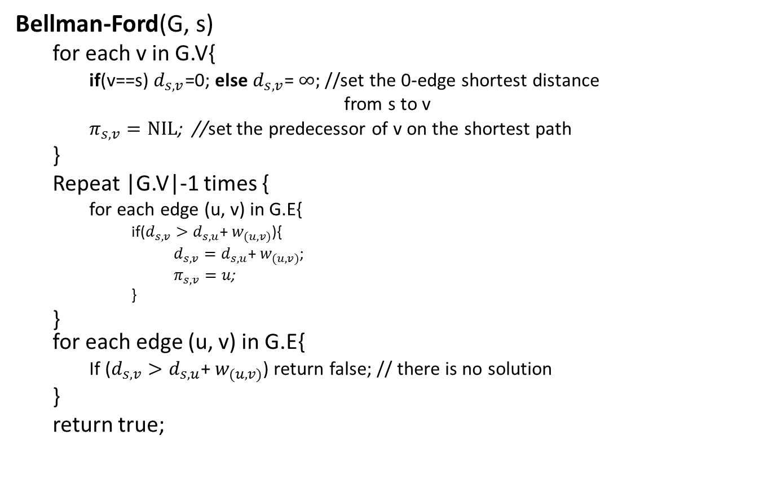
Bellman-Ford algorithm
Bellman-Ford(G, s)
for each v in G.V{
if(v==s) $d_{s,v}$=0; else $d_{s,v}$= $∞;$//set the 0-edge shortest distance
from s to v
$π_{s,v}=NIL$; //set the predecessor of v on the shortest path
}
Repeat |G.V|-1 times {
for each edge (u, v) in G.E{
if($d_{s,v}>d_{s,u}$+ $w_{(u,v)}$){
$d_{s,v}=d_{s,u}\text{+ }w_{(u,v)}$;
$π_{s,v}=u$;
}
} for each edge (u, v) in G.E{
If ($d_{s,v}>d_{s,u}$+ $w_{(u,v)}$) return false; // there is no solution
}
return true;
//Initialize 0-edge shortest paths
//bottom-up construct 0-to-(|V|-1)-edges shortest paths
//test negative cycle
T(n)=O(VE)=O($V^{3}$)

Slide 12

Bellman-Ford algorithm
e.g.
20
0
$$∞$$
$$∞$$
1
10
2
1
3
What is the 0-edge shortest path from 1 to 1?
<> with path weight 0
What is the 0-edge shortest path from 1 to 2?
<> with path weight $∞$
What is the 0-edge shortest path from 1 to 3?
<> with path weight $∞$

Slide 13








Bellman-Ford algorithm
e.g.
$$∞>0+20$$
20
$$d_{1,3}=20$$
0
$$∞$$
$$/10$$
$$∞$$
$$/20$$
$$∞>0+10$$
1
10
2
1
3
$$d_{1,2}=10$$
What is the at most 1-edge shortest path from 1 to 1?
$∞=∞$+1
<> with path weight 0
$$d_{1,3} unchanged$$
What is the at most 1-edge shortest path from 1 to 2?
<1, 2> with path weight 10
What is the at most 1-edge shortest path from 1 to 3?
<1, 3> with path weight 20
In Bellman-Ford, they are calculated by scan all edges once

Slide 14








Bellman-Ford algorithm
e.g.
$$0+20=20$$
20
$$d_{1,3} unchanged$$
0
$$/10$$
$$10$$
$$/11$$
10
20
$$10=0+10$$
1
2
1
3
$$d_{1,2} unchanged$$
What is the at most 2-edges shortest path from 1 to 1?
$20>10$+1
<> with path weight 0
$$d_{1,3}=11$$
What is the at most 2-edges shortest path from 1 to 2?
<1, 2> with path weight 10
What is the at most 2-edges shortest path from 1 to 3?
<1, 2, 3> with path weight 11
In Bellman-Ford, they are calculated by scan all edges once

Slide 15


Bellman-Ford algorithm
All 0 edge shortest paths
5
$$∞$$
$$∞$$
2
-2
3
6
-3
0
8
1
7
-4
7
2
4
5
$$∞$$
$$∞$$
9

Slide 16




Bellman-Ford algorithm
Calculate all at most 1 edge shortest paths
5
$$∞$$
$$/6$$
$$∞$$
/$∞$
2
-2
3
6
-3
0
/0
8
1
7
-4
7
2
4
5
$$∞$$
/$∞$
$$∞$$
/$∞$
/$7$
9

Slide 17
Bellman-Ford algorithm
Calculate all at most 2 edges shortest paths
5
$$/6$$
$$∞$$
/11
6
/4
2
-2
3
6
/0
-3
0
8
1
7
-4
7
2
4
5
7
$$∞$$
/2
/7
9

Slide 18

Bellman-Ford algorithm
Calculate all at most 3 edges shortest paths
5
$$/2$$
4
/4
$$/6$$
6
2
-2
3
6
/0
-3
0
8
1
7
-4
7
2
4
5
7
2
/2
/7
9

Slide 19

Bellman-Ford algorithm
Calculate all at most 4 edges shortest paths
5
$$/2$$
4
/4
2
2
-2
3
6
/0
-3
0
8
1
7
-4
7
2
4
5
7
2
/-2
/7
9

Slide 20
Bellman-Ford algorithm
Final result:
5
2
4
2
-2
3
6
-3
0
8
1
7
-4
7
2
4
5
7
-2
9
What is the shortest path from 1 to 5?
1, 4, 3, 2, 5
What is the shortest path from 1 to 2, 3, and 4?
What is weight of this path?
-2

Slide 21

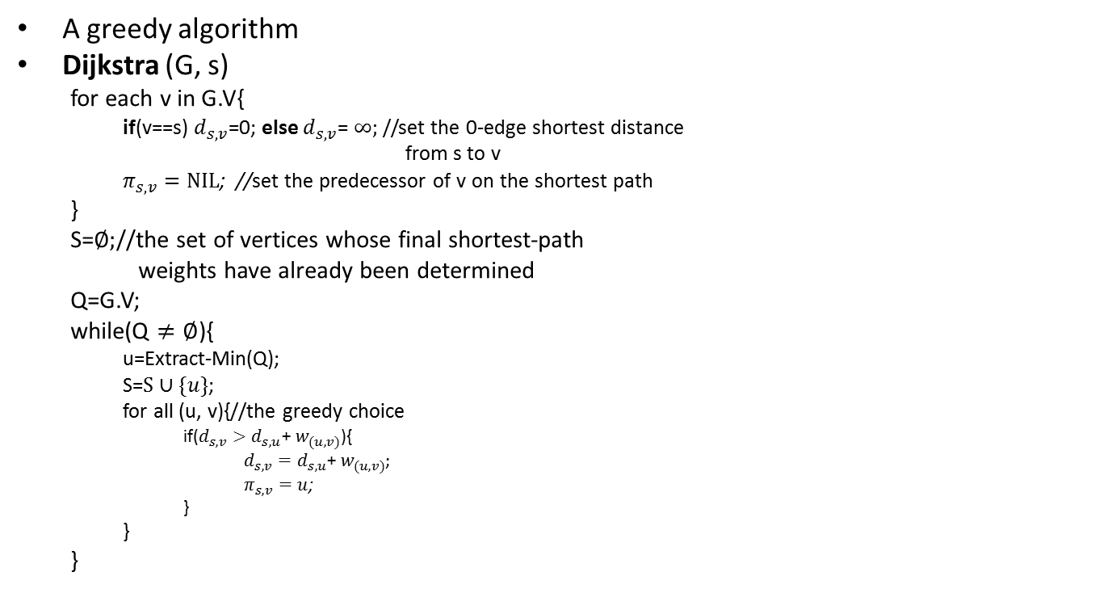
Dijkstra’s Algorithm
A greedy algorithm
Dijkstra (G, s)
for each v in G.V{
if(v==s) $d_{s,v}$=0; else $d_{s,v}$= $∞;$//set the 0-edge shortest distance
from s to v
$π_{s,v}=NIL$; //set the predecessor of v on the shortest path
}
S=$∅;$//the set of vertices whose final shortest-path
weights have already been determined
Q=G.V;
while(Q $≠∅$){
u=Extract-Min(Q);
S=$S∪\{u\}$;
for all (u, v){//the greedy choice
if($d_{s,v}>d_{s,u}$+ $w_{(u,v)}$){
$d_{s,v}=d_{s,u}\text{+ }w_{(u,v)}$;
$π_{s,v}=u$;
}
}
}
T(n)=O($V^{2}$)

Slide 22


Dijkstra’s Algorithm
The shortest path of the vertex with smallest distance is determined
1
$$∞$$
$$/10$$
$$∞$$
2
3
10
0
3
2
9
1
6
4
5
7
4
5
$$∞$$
$$/5$$
$$∞$$
2

Slide 23




Dijkstra’s Algorithm
Choose a vertex whose shortest path is now determined
1
10
$$/8$$
$$∞$$
$$/14$$
2
3
10
0
3
2
9
1
6
4
5
7
4
5
$$5$$
$$∞$$
$$/7$$
2

Slide 24



Dijkstra’s Algorithm
Choose a vertex whose shortest path is now determined
1
14
8
$$/13$$
2
3
10
$$/0$$
9
0
3
2
1
6
4
5
7
4
5
$$5$$
$$7$$
2

Slide 25

Dijkstra’s Algorithm
Choose a vertex whose shortest path is now determined
1
$$/9$$
8
13
2
3
10
0
3
2
9
1
6
4
5
7
4
5
$$5$$
$$/5$$
$$7$$
2

Slide 26

Dijkstra’s Algorithm
Choose a vertex whose shortest path is now determined
1
8
9
2
3
10
0
3
2
9
1
6
4
5
7
4
5
$$5$$
$$7$$
$$/7$$
2

Slide 27
Dijkstra’s Algorithm
Final result:
1
8
9
2
3
10
0
3
2
9
1
6
4
5
7
4
5
$$5$$
$$7$$
2
What is the shortest path from 1 to 5?
1, 4, 5
What is the shortest path from 1 to 2, 3, and 4?
What is weight of this path?
7

Slide 28
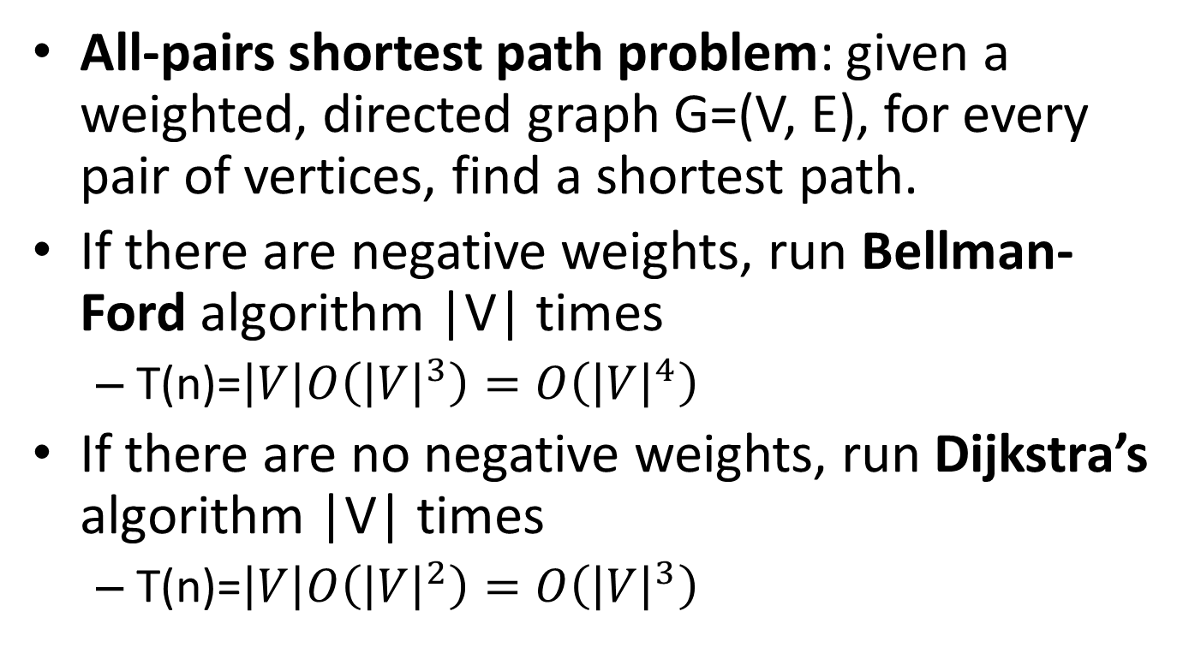
All-pairs shortest paths
All-pairs shortest path problem: given a weighted, directed graph G=(V, E), for every pair of vertices, find a shortest path.
If there are negative weights, run Bellman-Ford algorithm |V| times
T(n)=$\left|V\right|O\left({\left|V\right|}^{3}\right)=O\left({\left|V\right|}^{4}\right)$
If there are no negative weights, run Dijkstra’s algorithm |V| times
T(n)=$\left|V\right|O\left({\left|V\right|}^{2}\right)=O\left({\left|V\right|}^{3}\right)$

Slide 29
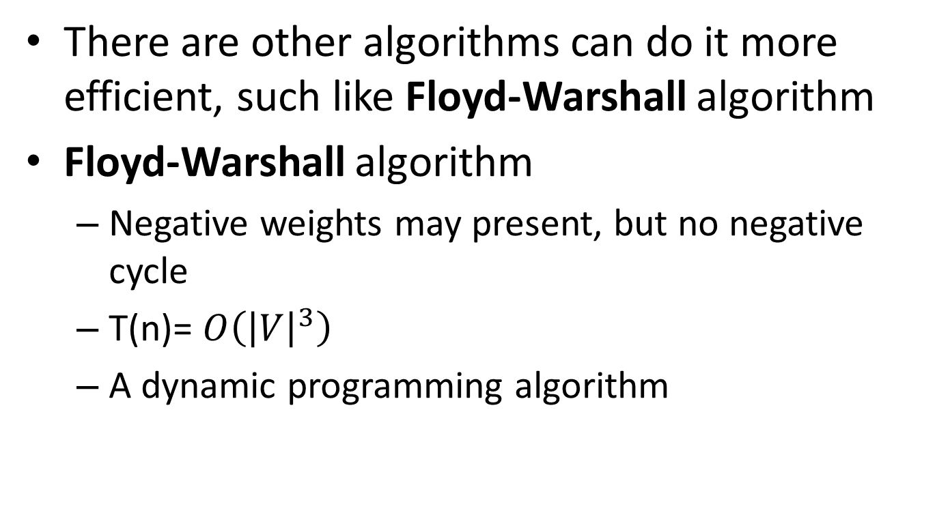
All-pairs shortest paths
There are other algorithms can do it more efficient, such like Floyd-Warshall algorithm
Floyd-Warshall algorithm
Negative weights may present, but no negative cycle
T(n)= $O\left({\left|V\right|}^{3}\right)$
A dynamic programming algorithm

Slide 30
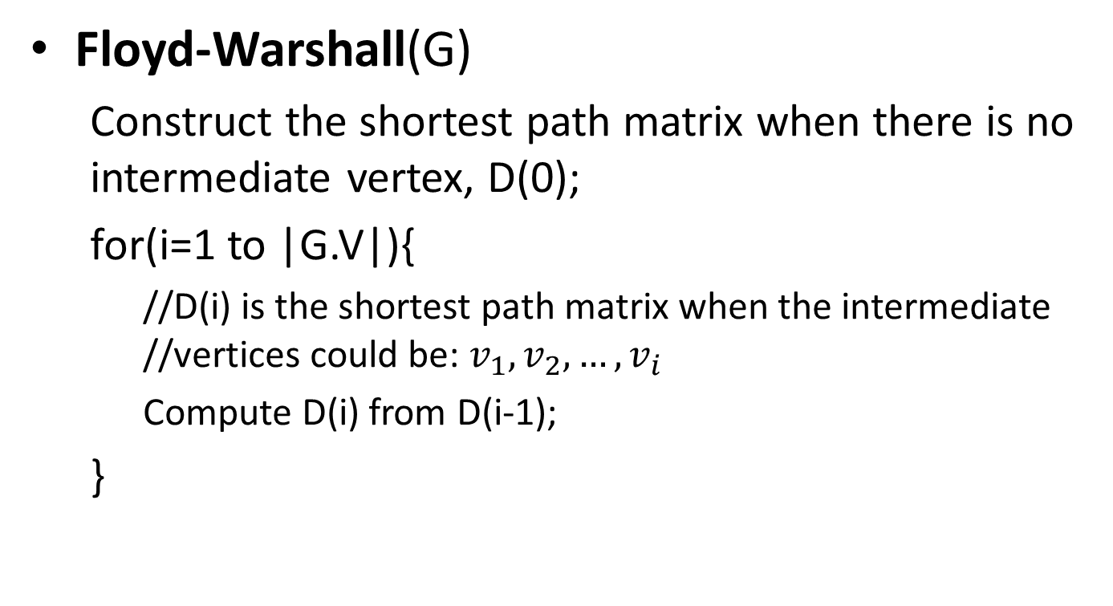
All-pairs shortest paths
Floyd-Warshall(G)
Construct the shortest path matrix when there is no intermediate vertex, D(0);
for(i=1 to |G.V|){
//D(i) is the shortest path matrix when the intermediate //vertices could be: $v_{1},v_{2}, …,v_{i}$
Compute D(i) from D(i-1);
}

Slide 31










All-pairs shortest paths
What are the weights of shortest paths with no intermediate vertices, D(0)?
1
2
 | 1 | 2 | 3 | 4
1
2
3
4
9
3
0
$$∞$$
$$∞$$
$$∞$$
6
4
$$∞$$
$$0$$
$$∞$$
4
3
$$9$$
$$0$$
2
3
4
$$∞$$
6
$$∞$$
0
2

Slide 32















All-pairs shortest paths
D(0)
 | 1 | 2 | 3 | 4
1
2
3
4
0
$$∞$$
$$∞$$
$$∞$$
1
2
$$∞$$
0
$$∞$$
4
3
2
0
9
2
$$∞$$
6
$$∞$$
0
3
6
4
What are the weights of shortest paths with intermediate vertex 1?
3
4
D(1)
 | 1 | 2 | 3 | 4
1
2
3
4
9
0
$$∞$$
$$∞$$
$$∞$$
$$∞$$
0
$$∞$$
4
3
$$2$$
0
9
$$∞$$
6
$$∞$$
0

Slide 33












All-pairs shortest paths
D(1)
 | 1 | 2 | 3 | 4
1
2
3
4
0
$$∞$$
$$∞$$
$$∞$$
1
2
$$∞$$
0
$$∞$$
4
3
$$2$$
0
9
2
$$∞$$
6
$$∞$$
0
3
4
6
4
What are the weights of shortest paths with intermediate vertices 1 and 2?
3
4
D(2)
 | 1 | 2 | 3 | 4
1
2
3
4
9
0
$$∞$$
$$∞$$
$$∞$$
$$∞$$
0
$$∞$$
4
3
$$2$$
0
6
$$∞$$
6
$$∞$$
0

Slide 34
















All-pairs shortest paths
D(2)
 | 1 | 2 | 3 | 4
1
2
3
4
0
$$∞$$
$$∞$$
$$∞$$
1
2
$$∞$$
$$∞$$
0
4
3
$$2$$
0
6
2
3
$$∞$$
6
$$∞$$
0
6
4
What are the weights of shortest paths with intermediate vertices 1, 2 and 3?
3
4
D(3)
 | 1 | 2 | 3 | 4
1
2
3
4
9
0
$$∞$$
$$∞$$
$$∞$$
$$∞$$
0
$$∞$$
4
3
$$2$$
0
6
$$∞$$
6
$$∞$$
0

Slide 35





All-pairs shortest paths
D(3)
 | 1 | 2 | 3 | 4
1
2
3
4
0
$$∞$$
$$∞$$
$$∞$$
1
2
$$∞$$
0
$$∞$$
4
3
$$2$$
0
6
2
$$∞$$
6
$$∞$$
0
3
6
4
What are the weights of shortest paths with intermediate vertices 1, 2, 3 and 4?
3
D(4)
4
 | 1 | 2 | 3 | 4
1
2
3
4
9
0
$$∞$$
$$∞$$
$$∞$$
$$∞$$
0
$$∞$$
4
3
$$2$$
0
6
$$∞$$
6
$$∞$$
0

Slide 36
































All-pairs shortest paths
Add predecessor information to reconstruct a shortest path
If updated the predecessor i-j in D(k) is the same as the predecessor k-j in D(k-1)
D(0)
D(1)
 | 1 | 2 | 3 | 4
1
2
3
4
 | 1 | 2 | 3 | 4
1
2
3
4
0/n
$$∞/n$$
$$∞/n$$
$$∞/n$$
0/n
$$∞/n$$
$$∞/n$$
$$∞/n$$
$$∞/n$$
0/n
$$∞/n$$
4/2
$$∞/n$$
0/n
$$∞/n$$
4/2
3/3
$$2/3$$
0/n
9/3
3/3
$$2/3$$
0/n
9/3
$$∞/n$$
6/4
$$∞/n$$
0/n
$$∞/n$$
6/4
$$∞/n$$
0/n
D(2)
D(3)
 | 1 | 2 | 3 | 4
1
2
3
4
 | 1 | 2 | 3 | 4
1
2
3
4
0/n
$$∞/n$$
$$∞/n$$
$$∞/n$$
0/n
$$∞/n$$
$$∞/n$$
$$∞/n$$
$$∞/n$$
0/n
$$∞/n$$
4/2
$$∞/n$$
0/n
$$∞/n$$
4/2
3/3
$$2/3$$
0/n
6/2
3/3
$$2/3$$
0/n
6/2
$$∞/n$$
6/4
$$∞/n$$
0/n
$$∞/n$$
6/4
$$∞/n$$
0/n

Slide 37








All-pairs shortest paths
D(4)
1
2
 | 1 | 2 | 3 | 4
1
2
3
4
0/n
$$∞/n$$
$$∞/n$$
$$∞/n$$
2
$$∞/n$$
4/2
3
$$∞/n$$
0/n
6
4
3/3
$$2/3$$
0/n
6/2
$$∞/n$$
6/4
$$∞/n$$
0/n
3
4
9
What is the shortest path from 3 to 4?
3, 2, 4
What is weight of this path?
6

